Slide 1
Commercial Cruise Program (STII)
Meeting #2
Career Services
10/20/2022

Slide 2
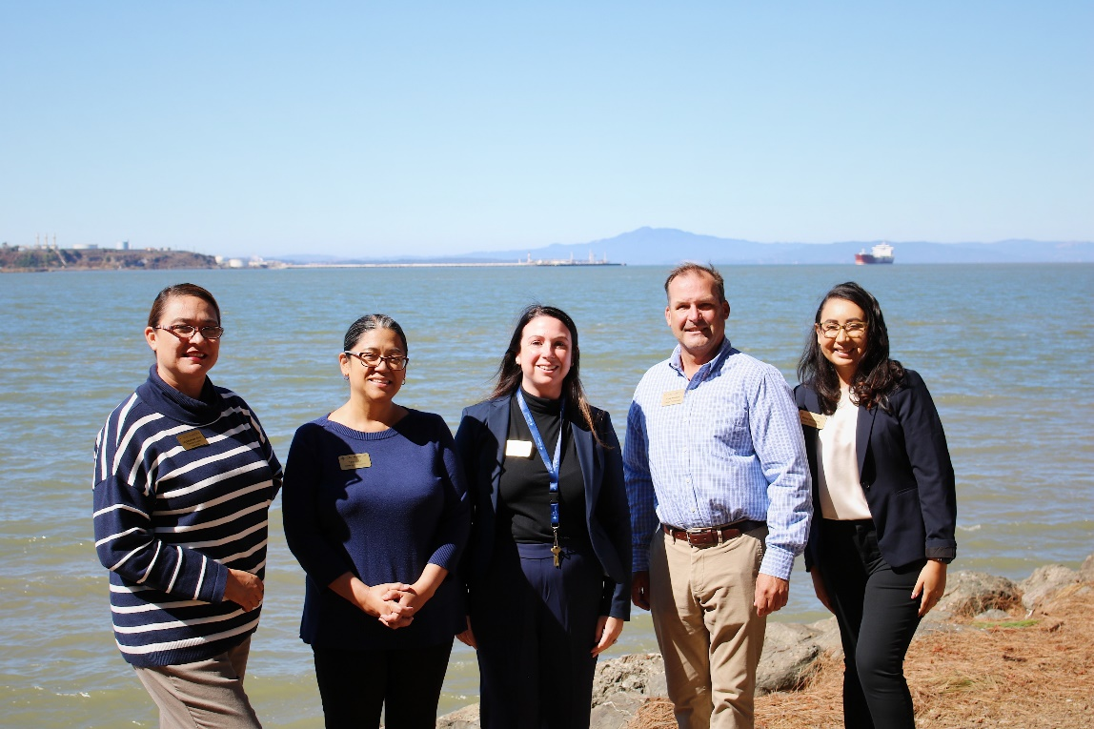
Office of Career Services
Director​
Lily Espinoza, Ed.D.​
​
Office Coordinator​
Tess Luna​
​
Career Coordinators​
Daisy Gonzalez – ​
Engineering (licensed/unlicensed)​
​
Chelsea Leff- ​
Marine Transportation (STII- Deck)
​
PRESENTATION SUB-TITLE
Other Information as Necessary
11/15/2017

Slide 3
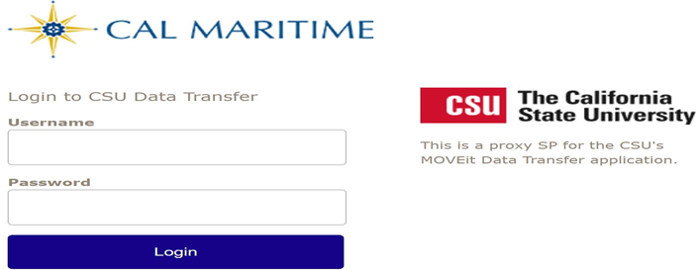
Uploading Required Documents
Requirements: Scan your required documents as a .PDF file and save it to your computer to upload on the secure website below.
*Please save your document in the following format: last name, first name (Document Name)
**Please make sure you are saving a COLOR copy that includes the front and back of the document (and all relevant pages)
Your log in is your CSUM EMAIL ADRESS and password.
1. Go to https://transfer.data.calstate.edu.
2. Select Maritime and Login
3. Authenticate with SSO (your school credentials) and Duo.

Slide 4
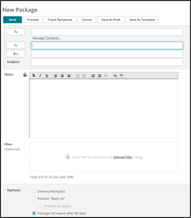
Uploading Required Documents Continued
4. Select "Send Package"
5.Fill in the recipient’s name to your designated career coordinator: Chelsea Leff (Deck) cleff@csum.edu or Daisy Gonzalez (Engine) dgonzalez@csum.edu.
6.Subject: Document Name (E.g. Passport, TWIC, etc.)
7.Notes: Enter Last Name and First Name, Email, and Contact Number
8.Upload your required documents mentioned above.
9.Click the red "Send" box.
10. Repeat process for all other documents

Slide 5
Required Documents: Cadet Data Sheet
Cadet Data Sheet is now past due
Please type out the Cadet Data Sheet, DO NOT handwrite
Make sure you are not submitting a blank copy
Upload Cadet Data Sheet to the Move It platform ASAP

Slide 6
Required Documents: Career Services Release of Information
CS ROI is now past due
Please carefully print your full name (first and last name); sign and date form
If you have not submitted the CS ROI, meet with a Career Services Staff member to complete one after the meeting

Slide 7
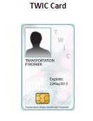
Required Documents: TWIC (Transportation Worker Identification Credential)
TWIC due Friday, October 21st
Upload and send to designated Career Coordinator via Move It
Upload a Color copy, front and back
Take note of expiration date to assess if it needs to be renewed (Must be valid through 2023)

Slide 8
Required Documents: Medical Insurance
A copy of your Medical Insurance Card is due Friday, October 28th
Make sure to upload a color copy, front and back to Move It platform
All cadets must obtain and show proof of valid medical insurance for the duration of their commercial cruise

Slide 9
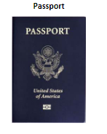
Required Documents: Passport
Passports will be due Friday, November 4th
If you need to renew your passport, you may submit a receipt of your renewal application to your designated Career Coordinator by the deadline
Assuming you return from your commercial cruise in August of 2023, you must have a passport valid through February 2024.
You must provide a copy of your passport to your designated Career Coordinator
*Please note: Passport must be valid at least 6 months from the final day of your cruise.

Slide 10
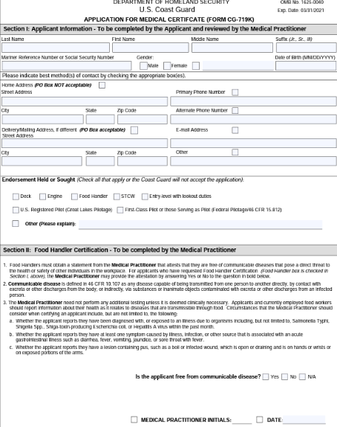
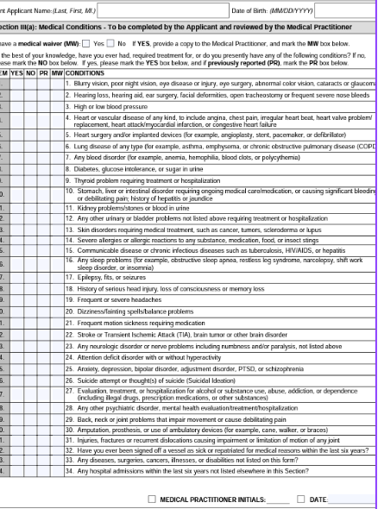
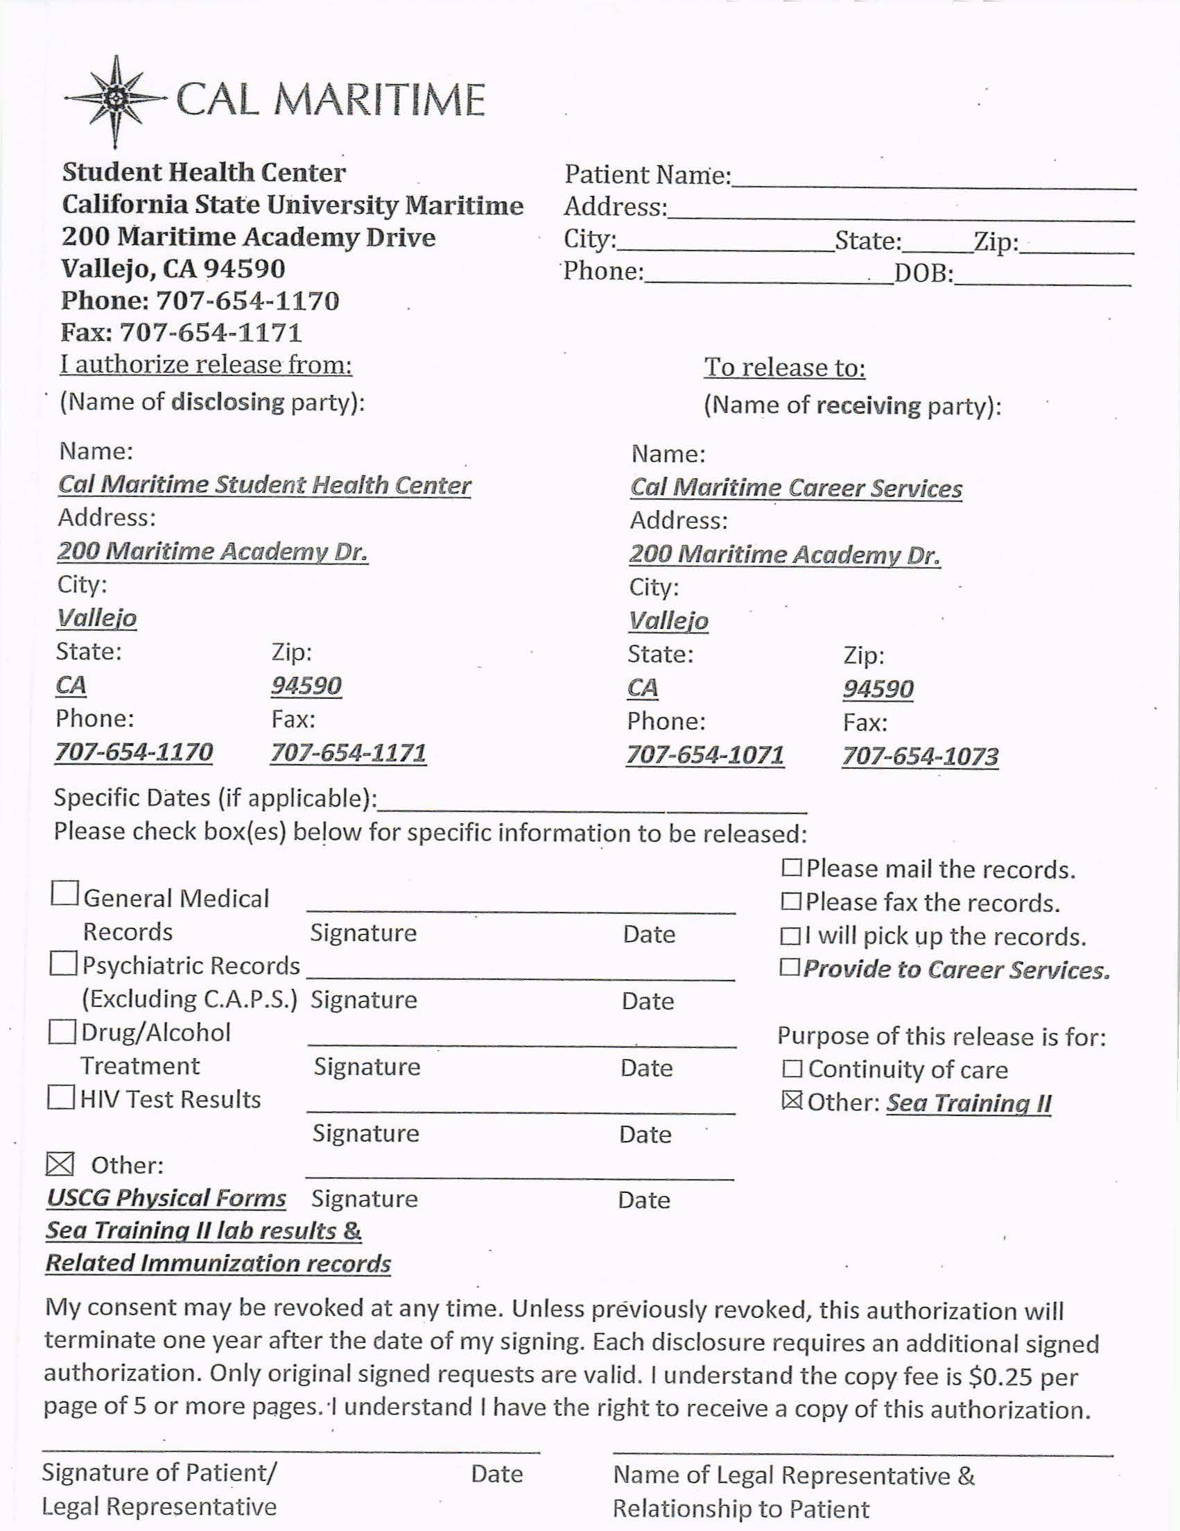
Required Documents: USCG Physicals
All students must have a USCG Physical valid through end of your commercial cruise, anticipated August 2023.
Physicals expire after one year.
Physicals may be completed in the Student Health Center.
You must sign a Student Health Center ROI at the time of your physical, in order for Career Services to provide this document to companies.
Please take a printed copy of the Medical ROI and the 719 K Form (Typed Out) to your physical appointment, then upload a copy of both document via Move It to your designated Career Coordinator
Please note the Medical ROI Form is not the same as the Career Services general ROI form
If you did not have your physical done on cruise this past summer, head to the student health center to have it done ASAP.
If you did have your physical done on cruise this past summer, please schedule an appointment to have it re-done at the beginning of Spring semester.
USCG physicals should be uploaded to Career Services no later than the end of Fall Semester
Some companies require extra physicals/blood tests—these procedures may be at the cadet’s personal expense.
Cadets who do not pass a company’s physical requirements are not allowed to sail with that company and are not guaranteed another billet.

Slide 11
Requirements (Quick Note)
Sea Time Requirements (based on Deck or Engine)
Deck: minimum 93 days
Engine: minimum 60 days
Vessel Requirements (based on Deck or Engine)
Deck: minimum 100 GRT, ideally at least 1600 GRT (Gross Registered Tons)
Engine: minimum 4000 HP (horsepower)
All companies required to participate in EMBARC (Every Mariner Builds a Respectful Culture) Agreements
For cadets going on a tanker vessel, all must take tanker course (NAU 320) or weekend course
If you have already completed CRU 200 or CRU 250 and partial sea time, you must enroll in CRU 390 (Deck) or CRU 395 (Engine)

Slide 12
Contacting Companies
You are welcome and encouraged to foster professional relationships with contacts in your top choice companies (consider LinkedIn, Job fairs)
Please do not cold call – all companies are contacted by Career Services.
Remember, when it comes to finalizing a billet for your commercial cruise, you must consult with your designated Career Coordinator, who will verify guidelines and requirements, and finalize the process.
Please note, some companies determine billets based on ranking list, resumes, and/or interviews

Slide 13
Contacting Companies​
Career Services will be sending an initial invitation to Companies to participate in Summer 2023 CCP in the month of October
As responses are coming in from companies, Career Services will track status of billet opportunities and share with all Deck and Engine Cadets
Please keep in mind some companies may not provide information on their Summer Billets until the Spring

Slide 14
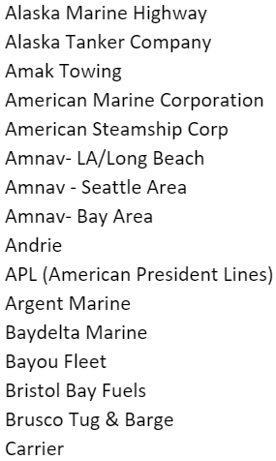
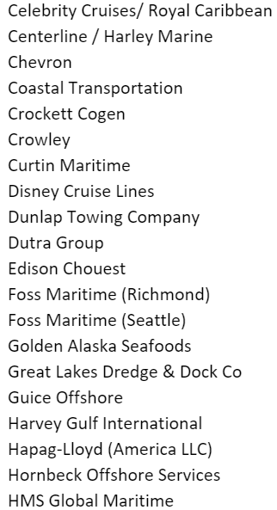
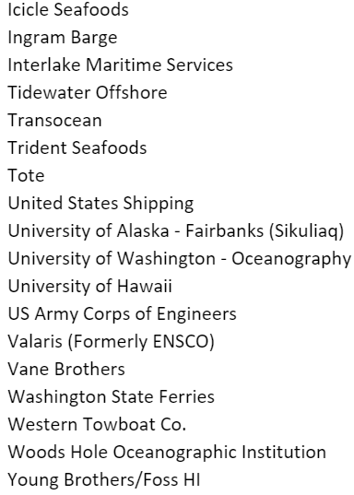
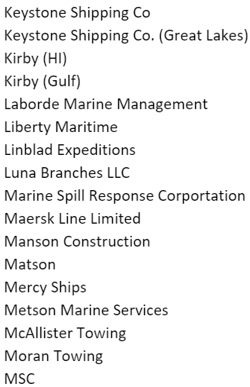
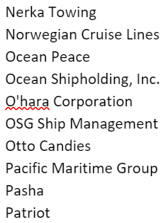
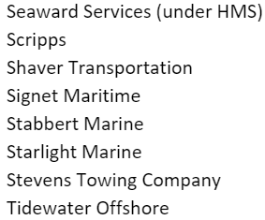
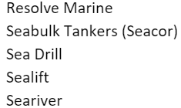

Slide 15
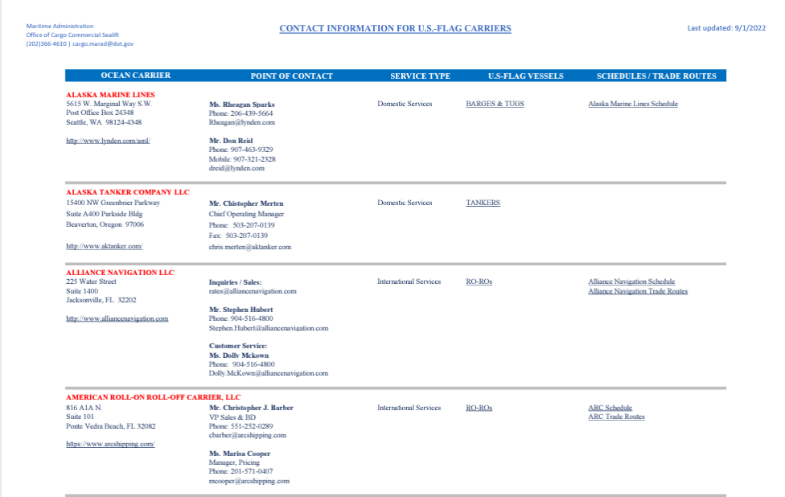
Company Research
U.S. Department of Transportation website
U.S. Flag Carriers
Information about type of vessels by company
Information on routes
Spring Career Fair
Tuesday, February 28th
Open to all majors
Location: PEAC
Time: 0900 - 1400

Slide 16
Company Research
Some Things to Keep in Mind When Considering a Company:
Does the company pay cadets for their commercial cruise?
What kind of vessels the company puts cadets on for commercial cruise?
Does the company cover travel costs?
Does the company provide visa sponsorships?
Are all vessels U.S. Flag?

Slide 17
Applying to Companies
Please note some companies may require a thorough application process; that may include resumes, essays, and additional documentation
Expl. Crowley, Military Sealift Command (MSC)
Interviews may also be required to secure a billet, when applying to certain companies

Slide 18
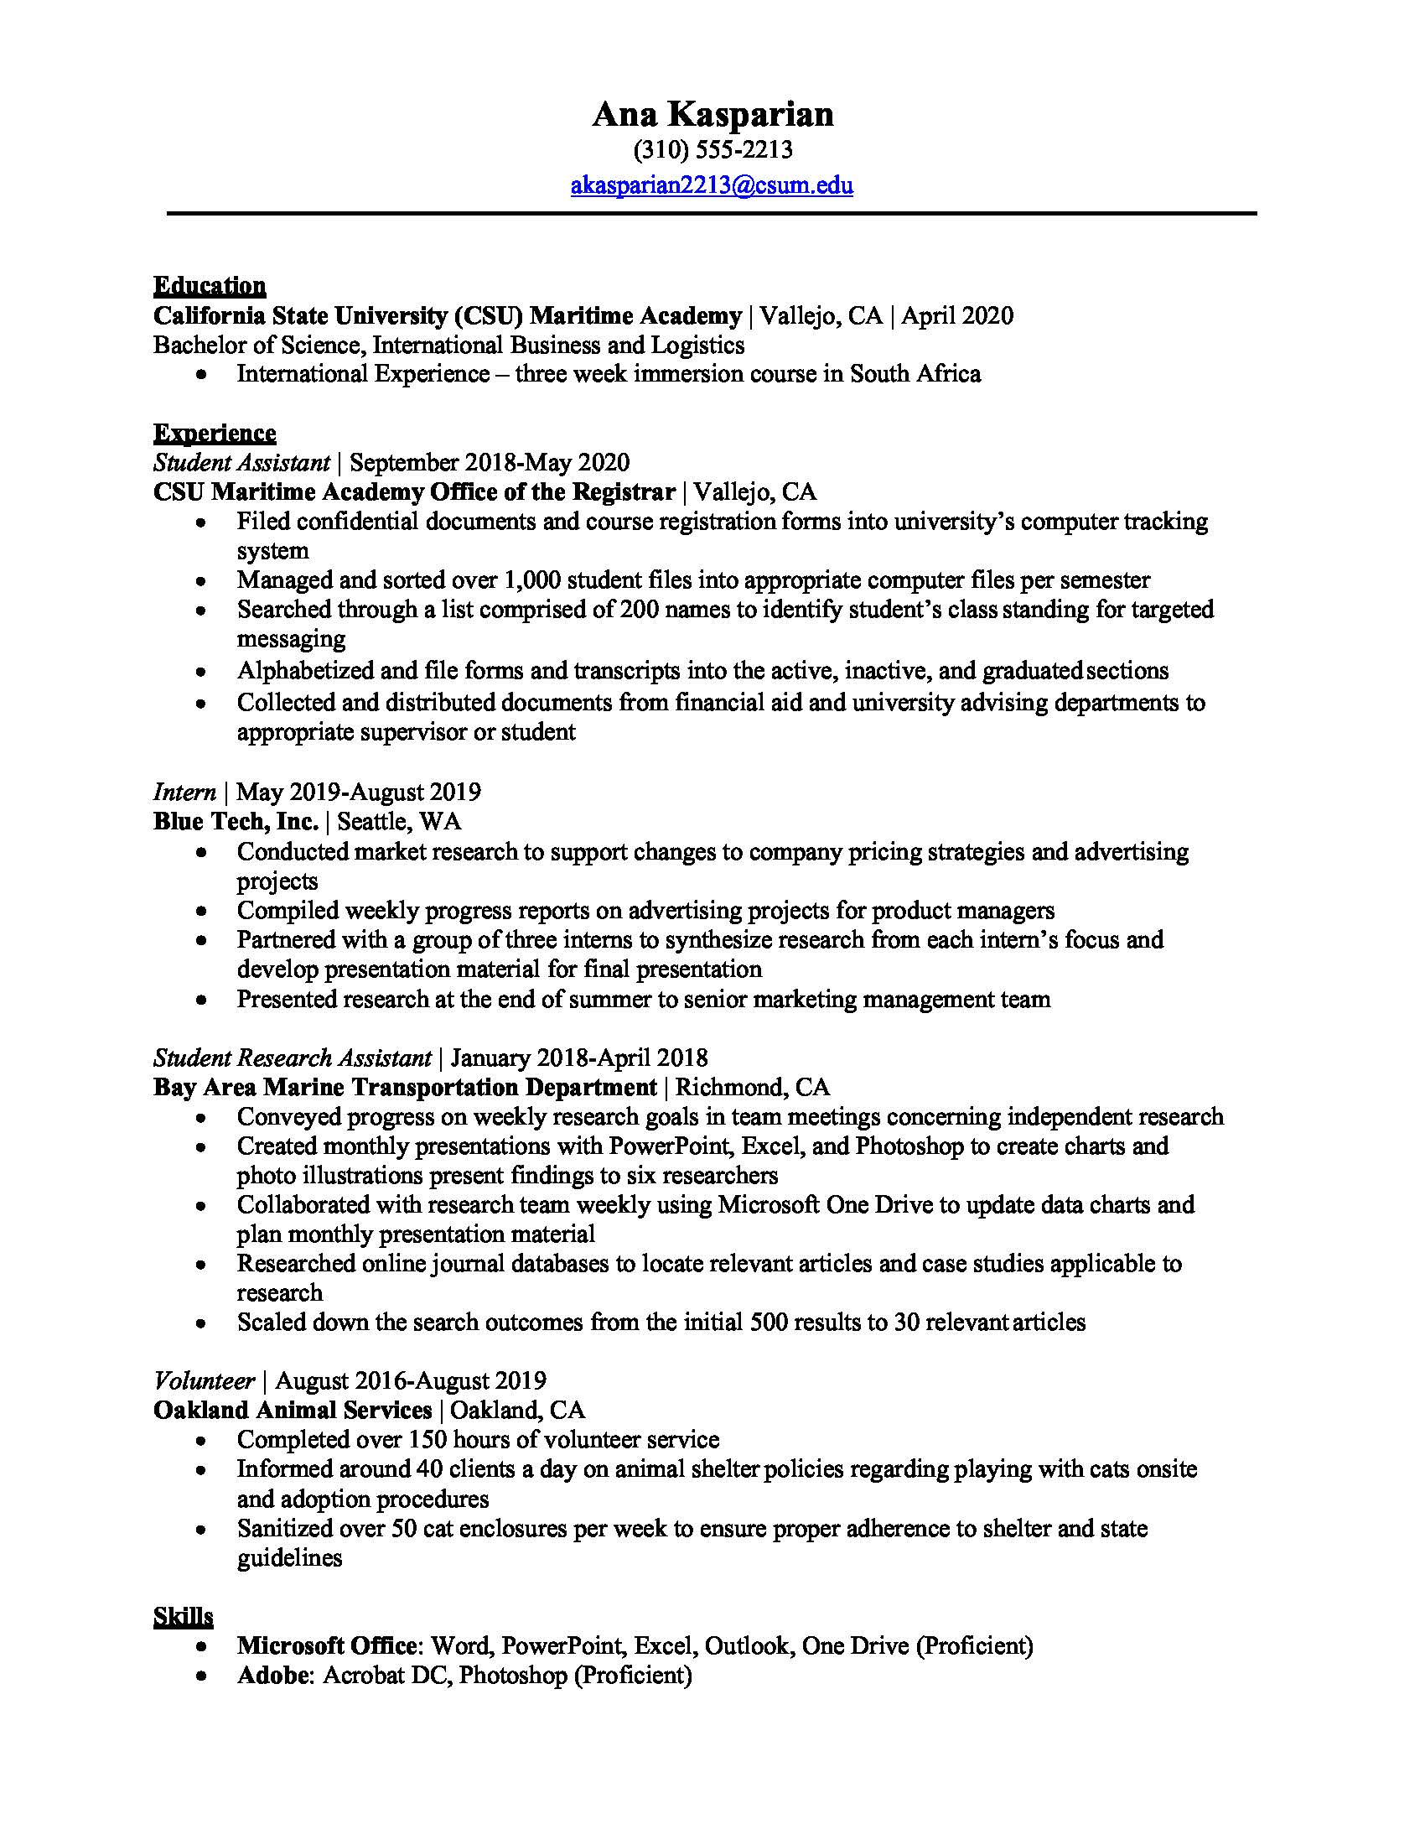
Applying to Companies (Resume)
Try to keep your resume to one page
You may include CRU 100/150 experience
Consider volunteer/community service positions you've had
If space permits, you may include any leadership roles, club roles, skills, certificates, etc.
Please utilize standard resume templates
For further assistance with your resume, schedule an appointment with your designated career coordinator

Slide 19
Billet Process (List)
1. Academic Performance (GPA)
Academic Performance will be scored based on overall cumulative GPA
GPA's under 2.575 will receive 0 points
GPA's of 4.000 and above will receive 20 points
GPA's between 2.575 and 4.000 will be assigned a number accordingly

Slide 20
Billet Process (List)
2. Commercial Cruise Preparedness
Based on turning in required CCP documents on time and attending CCP meetings
Cadets will receive 1 point for each upcoming documents submitted by the stated deadline
TWIC due Friday, October 21st
Medical Insurance Card due Friday, October 28th
Passport due Friday, November 4th
Additional document due dates to come

Slide 21
Billet Process (List)
3. Community Leadership
Cadets can receive up to 3 points from community leadership
Points will be provided to each leadership activity as follows:
Letter of Recommendation (Link to Come)
Community Engagement Service (10 hours or more)
Corp of Cadets chain of command or many other university student leadership position(s)

Slide 22
Upcoming Meetings (All located in Rizza)
Thursday, November 3rd from 1100-1200: Documents: MMC, TWIC, PIC, TOAR
Thursday, November 10th from 1100-1200: Military Sealift Command (MSC)
Thursday, January 26th from 1100-1200: Deck Panel: Student and Faculty Insight
Thursday, February 16th from 1100-1200: Engine Panel: Student and Faculty Insight
Thursday, March 16th from 1100-1200: Somewhere Satellite Devices
Thursday, March 23rd from 1100-1200: Cruise Protocols with CAPS, Title IX, Cal Police
Thursday, April 6th from 1100-1200: Discharge letters, Cadet Evaluations, and Cruise Conduct

Slide 23
CCP Handbook & Presentation
Part I: Before the Cruise is now available on Cal Maritime Career Services Webpage
All Commercial Cruise Presentations will be posted on Cal Maritime Career Services Webpage after each meeting

