Slide 1
FYE- Academic Advising

Slide 2
How do I know if I’m on track?
Meet with a University Advisor/Faculty Advisor
Curriculum Roadmaps
Academic Requirements Report (Peoplesoft)
Smart Planner/Academic Planner
Notes:
Show Website Pages:
Office of the Registrar
Forms
Curriculum Sheets
Electives List
Smart Planner Directions
Academic Requirements Report Directions

Slide 3
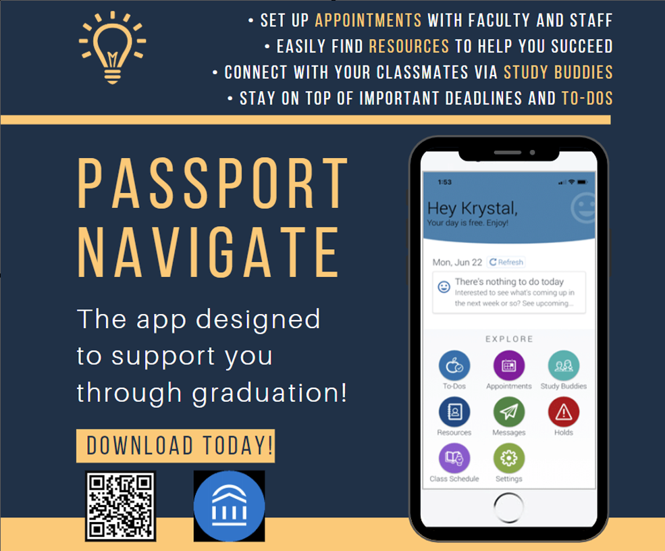
University Advising Webpage https://www.csum.edu/university-advising/
Advising Tools
How to Use your Schedule Planner and Smart Planner
Registration Tips
Elective Course List
College Success Tools
GPA Calculator
Outlook/Google Calendar: Tips for Time Management
Questions to Ask your Professor or Tutor
How to Stay Motivated in College
Passport Navigate for Students
Student Mobile App
Schedule Meetings with Faculty/Staff
Find Resources & Connect with your Peers!
Notes:
Show Website: https://www.csum.edu/university-advising/
Walk through pages and resources

Slide 4
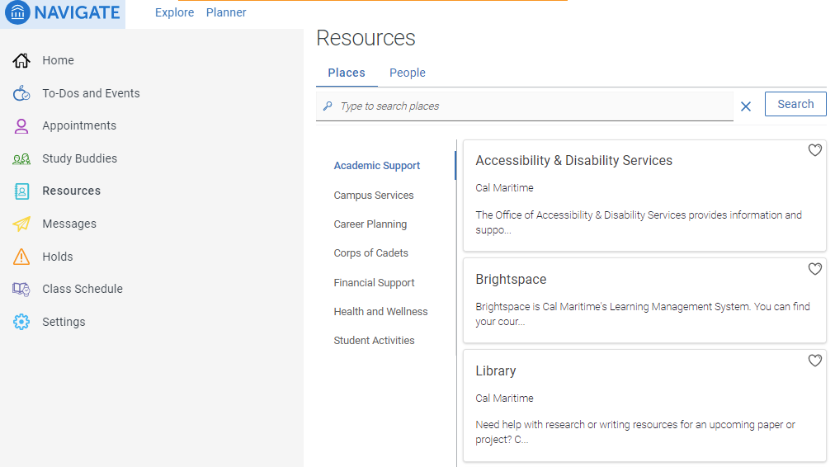
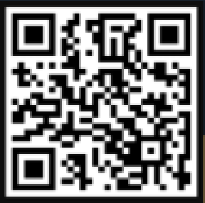
Tips for Success
Check your email 1x day minimum! (tip: set a reminder)
Write down your instructors’ office hours in your planner (listed in each of your syllabi)
Track your grades (Brightspace or ask your instructor)
Make a tutoring appointment early and often!
Download Passport
Navigate app!

Slide 5
What if I do fail a class?
Retake the class as soon as possible
you’ll raise your GPA and have an increased chance of passing the 2nd time!
Financial Aid Implications (SAP)
What happens if I transfer a course in?
Transfer courses only impact your Cumulative and Major GPA’s
Can any class be transferred in?
No! i.e. EGL 300, STCW, specialty courses, etc.
Get them pre-approved first!

Slide 6
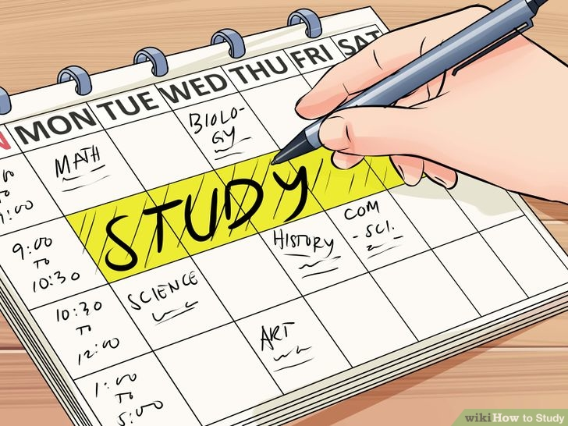
Academic Standing
Academic Probation:
GPA drops below 2.0 (any of 3 GPA’s)
Unit limitations (12-15)
Administrative Academic Probation:
Progress toward degree (Repeats)
16 unit limit (Grade Forgiveness)
Don’t forget!:
Withdrawal “W" unit limitations (18)
3X repeat course limitation
Notes:
Students must be in good academic standing to graduate.
Two types of probation: Academic and Administrative
Meet with a University Advisor for more information.

Slide 7
Important Dates
9/17: Last Day to Add/Drop a Class (2 Weeks)
10/4: Last Day to Withdraw From a Class (Census)
10/25: Academic Advising for Spring 2022
11/8-19: Registration for Spring 2022
11/25-26: Thanksgiving Break
12/18-21: Final Exams
12/23: Final Grades Posted

