Slide 1
First Year Experience Seminar 2021
Alcohol and Bystander Intervention
ADAPTED FROM MATERIALS BY:
Angeli Acosta, Health Educator
Vineeta Dhillon, Title IX Coordinator

Slide 2
Today's Agenda
Introductions (10 min)
Ground Rules (5 min)
Social Norming: Understanding Experiences with Alcohol (5 min)
Alcohol: “Take a step forward... “ Activity (15 min)
Bystander Intervention: 5 D’s Intervention Activity (15 min)
Questions and Wrap Up (5 min)

Slide 3
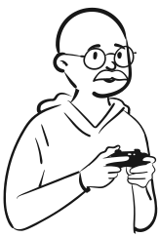
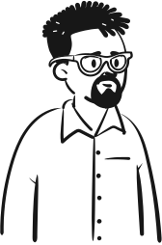
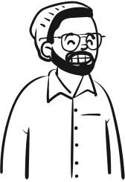
Ground Rules
Be respectful, be open-minded, be non-judgmental, be honest, speak one-at-a-time and allow everyone a chance to contribute.

Slide 4
My experience with alcohol @ Cal Maritime

Slide 5
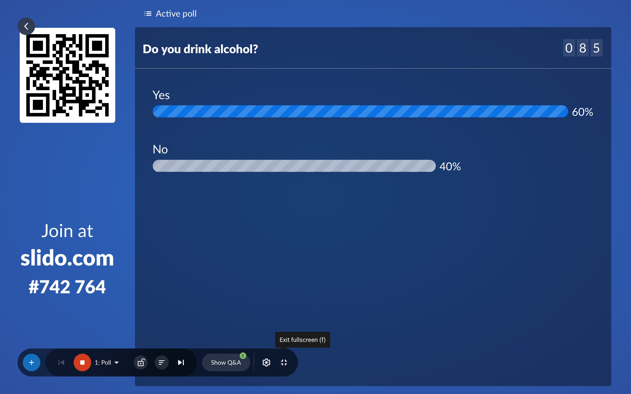

Slide 6
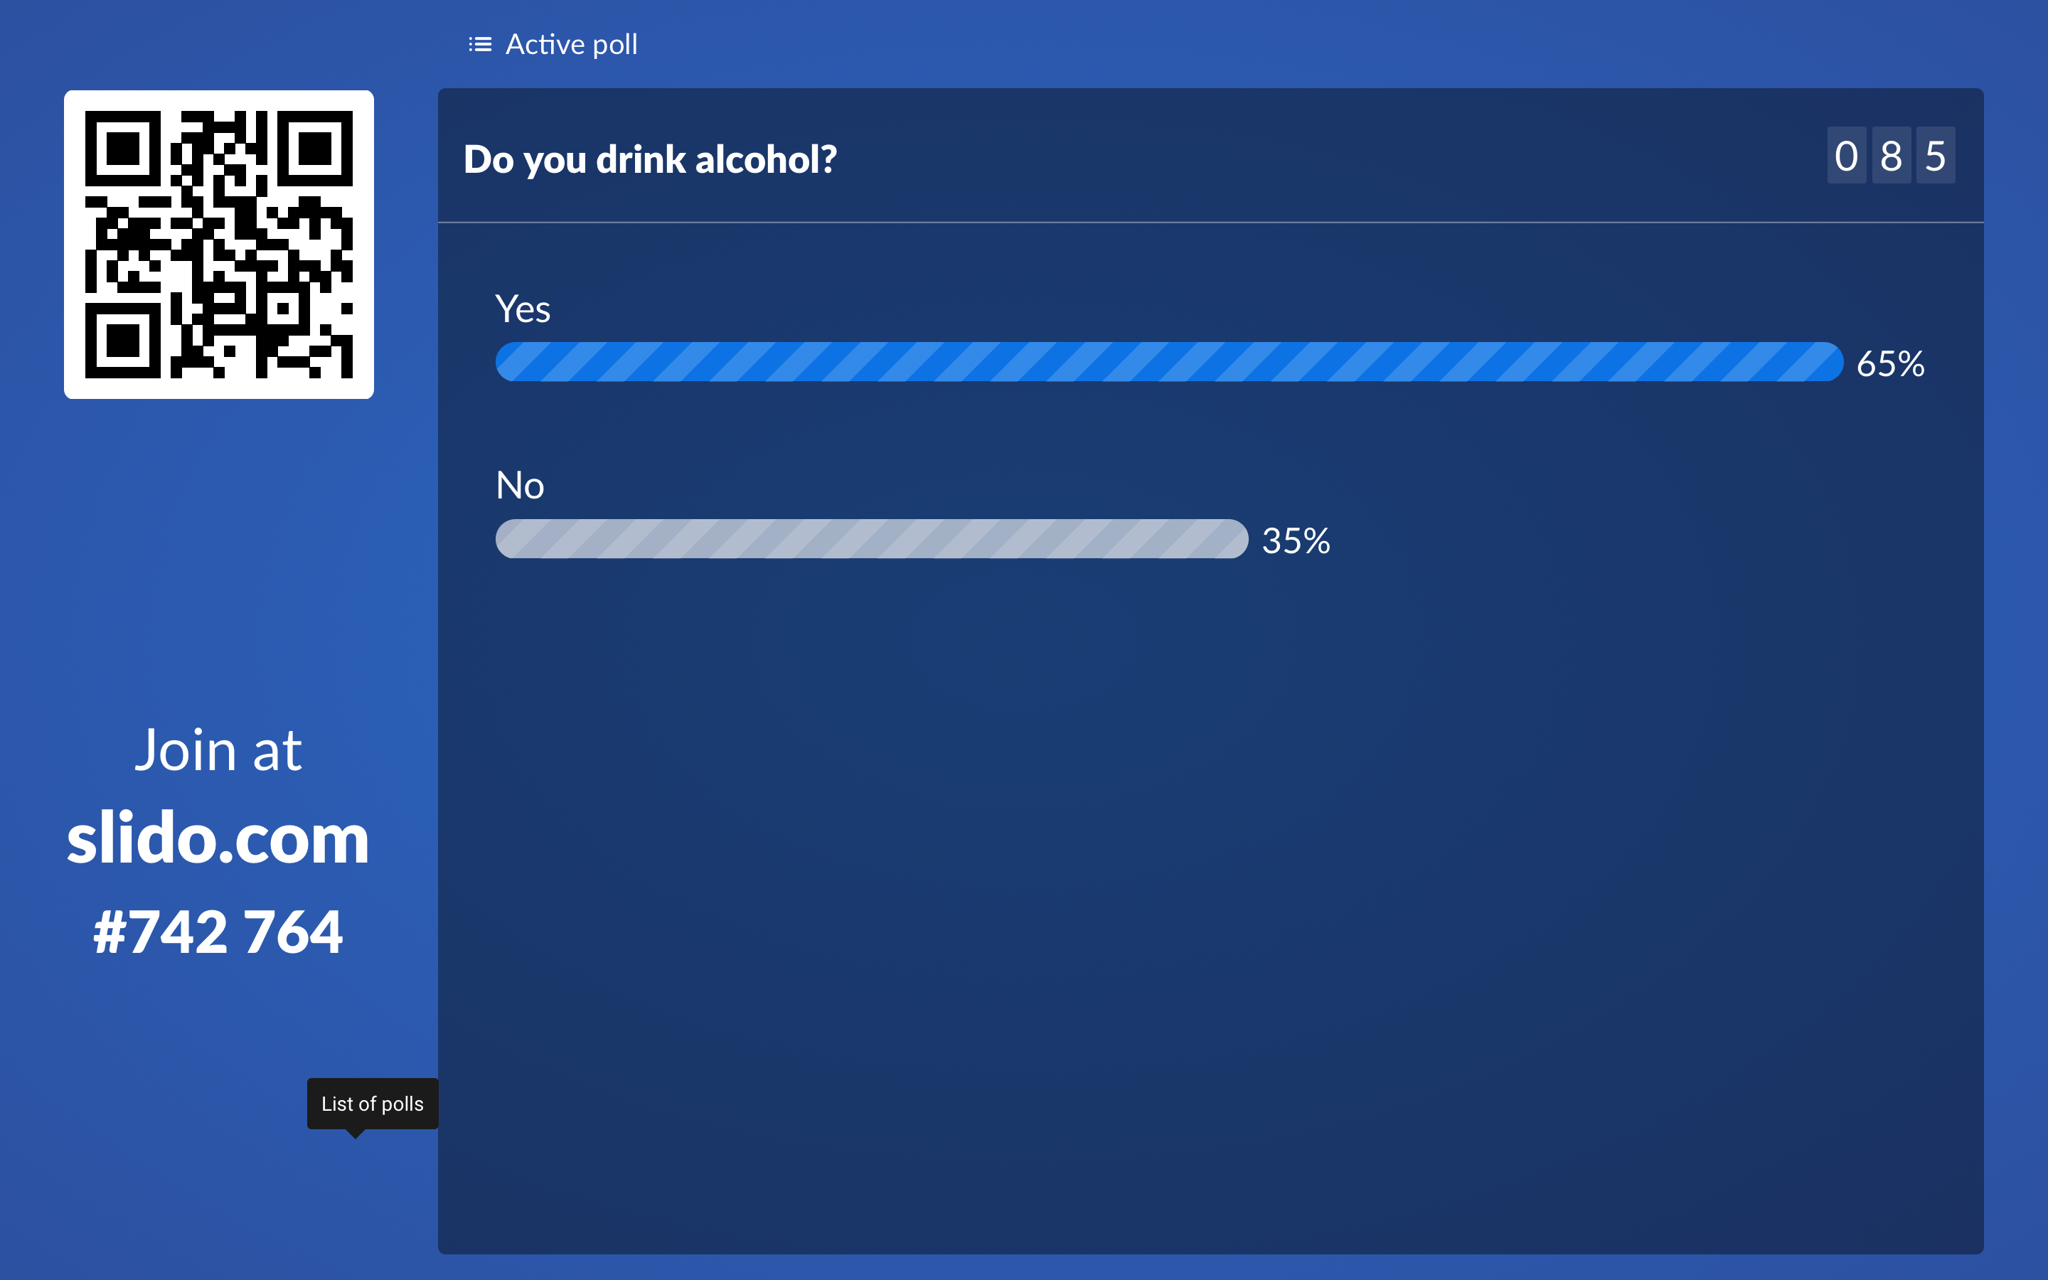

Slide 7
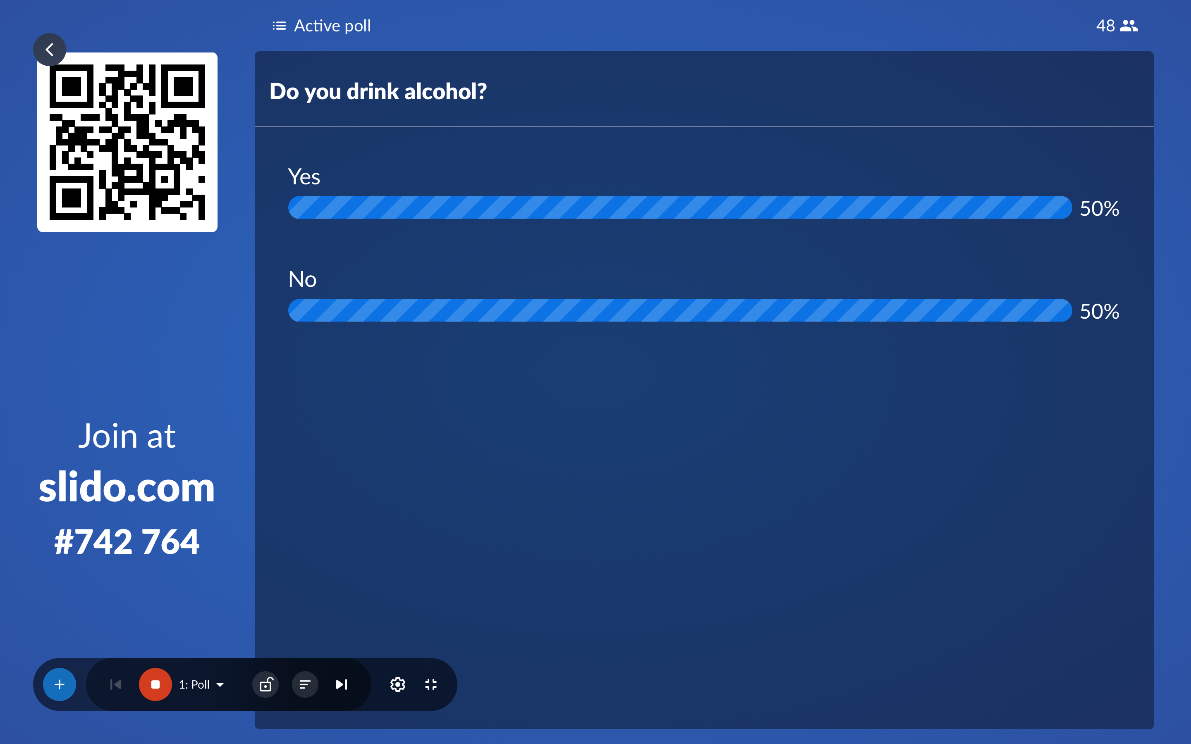
Notes:
Emphasize how many people drink – but also take note of cadets who don't drink. They are not the only ones and its ok not to drink.

Slide 8
Take a step forward…
Cadets will separate themselves into a circle, facilitator speaking will be at the center.
Facilitator will call out some questions around alcohol.
Cadets will take a step into the circle if they have experienced it and the facilitator can ask follow up questions.
Cadets will take a step back before the next question is called.
Alcohol Education Activity

Slide 9
The Five D's:
Direct - Approach the people involved directly. Always put your safety first and be as nonconfrontational as possible.
Distract: Strike up a conversation about something random or find other creative ways to distract them. It can be something as simple as complimenting the person’s shoes.
Delegate: Ask a friend who knows the person better to check in or call 911 if the situation is serious.
Delay: If you can’t take action in the moment, you can still make a difference by checking on the people afterwards and asking how you can help or offering resources.
Document: There are different ways to document something – by videotaping; written documentation; documenting reports; etc. Irrefutable facts are very important.

Slide 10
The 5 Ds Scenarios
Facilitators will ask for a volunteer to reach one of the scenarios.
Facilitators will call one of the Ds for an intervention and ask how someone could react to help in this situation, using that strategy.
Bystander Intervention Activity

Slide 11
Angeli Acosta Health Educator
Do you have
any questions?
amacosta@csum.edu
Vineeta Dhillon
Title IX Coordinator
Get in touch with us.
vdhillon@csum.edu

