Slide 1
First Year Experience
Seminar 7: Diversity, Equity, & Inclusion
11/9 and 11/11/2021

Slide 2
Agenda
Ground Rules Reminder (5 min)​
Check-In (5 min)​
Cultural Humility (10-15 min)​
Activity (15 min)​
Resources & Wrap Up (10 min)

Slide 3
Reminder of Ground Rules
Respect
“I” Statements
Self-Care
Assume positive intent, acknowledge the impact
Other Information as Necessary
11/15/2017
Notes:
Respect – we want to respect each other's opinions even if they are different; this means allowing someone to share authentically and not laughing at someone else's perspectives or opinions​
​
"I" statement – you are encouraged to speak from your personal experiences and share your truth; it is important to not generalize that ALL members of a group feel the same way​
​
Self-care – it is okay if you need to take care of yourself by taking a step out, choosing not to share, ​
​
Assume positive intent/acknowledge the impact – we are in this space to learn together; please don’t assume that everyone has negative intentions based on what they say or do; however, the impact of someone's words may still be negative so it is important that we acknowledge it to learn from it​

Slide 4
Check-In
On a scale of 1-5 (5 being the best, 1 being the worst), how would you rate your 1st semester so far?
What experiences contributed to your score?
On a scale of 1-5 (5-strongly agree, 4-agree, 3-neutral, 2-disagree, 1-strongly disagree), how would you rate your overall agreement with the statement: “Cal Maritime is a place where I belong.”
What experiences contributed to your score?
Other Information as Necessary
11/15/2017
Notes:
This is meant to be a brief check-in that allows everyone to participate. When asking "what experiences contributed to your score", the recommendation is to ask for 1-2 volunteers for each question only. Do not linger on what students share because there will be more time to address or talk about experiences in depth.​

Slide 5
Cultural Humility
Coined in the 1990s in the healthcare profession to improve health services for people from different cultural backgrounds and identities​
"A lifelong process of self-reflection & self-critique whereby the individual not only learns about another's culture but starts with an examination of their own beliefs & cultural identities" (Tervalon & Murray-Garcia, 1998).​
Not about being "politically correct" or shaming others for not knowing, rather more as a commitment to be open and learn about differences as well as reflect on your personal experiences
Other Information as Necessary
11/15/2017
Notes:
Cultural humility is an important concept to the work of Diversity, Equity, and Inclusion. Cultural humility was coined in the 1990s in the healthcare profession. It was developed as a framework to help therapists and social workers learn more about the experiences and cultural identities of their clients to increase the quality of their health services.​
​Cultural humility is focused on self-reflection and lifelong learning. It is about understanding that others may identify with different cultural backgrounds that are important to who they are. Through cultural humility, people reflect on their own personal background and identities, and show a willingness to learn about different cultural identities.​

Slide 6
Cultural Humility
Goals: encourage personal reflection & awareness ​
Values: introspection & co-learning​
Shortcomings: no end result (remember --> lifelong learning)​
Strengths: appreciation for the journey of growth and understanding ​
Other Information as Necessary
11/15/2017
Notes:
Goals: encourage people to reflect on their own personal experiences and increase their awareness about different cultural backgrounds​
​
Values: emphasizes introspection and learning with each other ​
​
Shortcomings: it can be difficult because there's no end result, meaning you don't know necessarily when you've become competent in your cultural awareness; it's not about completing workshops or earning a certificate that you're an expert on cultural awareness – it's more of a mindset that you are okay with the thought that you'll always be learning as culture changes​
​
Strengths: helps people appreciate the journey of personal growth and understanding towards different cultures, backgrounds, and identities​

Slide 7
Activity - Circles of Myself
On the handout, write your name in the center circle.
(1-2 min) On the outer circles, write an important aspect of your identity in each circle. Examples can include Asian American, male, athlete, educator, brother, Christian, etc.
Other Information as Necessary
11/15/2017

Slide 8
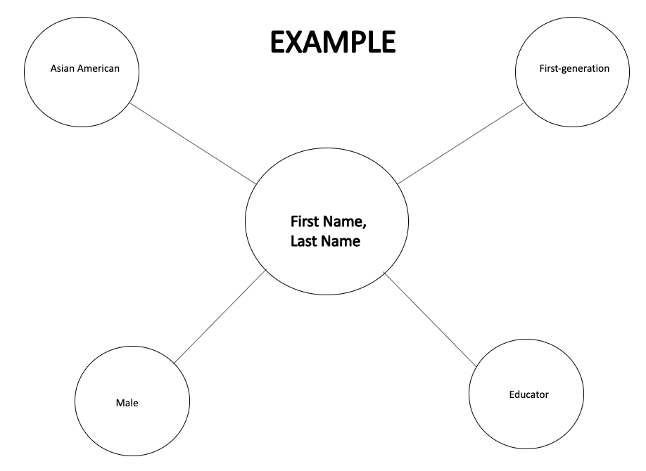
Activity - Circles of Myself
Other Information as Necessary
11/15/2017

Slide 9
Activity - Circles of Myself
(5 min) Find a partner and share a story about a time that you were especially proud to identify with one of the descriptors used above. Take turns after 2 min each.​
(5 min) Find a new partner and share a story about a time it was painful to be identified with one of the descriptors above.​
(2-3 min) Name a stereotype associated with one of the groups which you identify with that is NOT consistent with who you are & complete the following sentence:​
"I am a/an , but I am NOT a/an ”.
(2-3 min) Go around the room and have everyone take turns sharing their statement. This is a silent activity.
Other Information as Necessary
11/15/2017
Notes:
Feel free to change/accommodate depending on time. If time permits, please do both partner swaps. If time is limited, have students only do 1 partner swap and choose whether to share a proud or painful experience.​
​
*PRIORITIZE: Allow students to complete the sentence. Then, EMPHASIZE that it should be a SILENT moment when you go around the room and have people taking turns sharing their statement.​

Slide 10
Discussion Questions
Why & how did you choose certain descriptors or identifiers? Why were they important to you?​
How did it feel to be able to share your proud and painful moments with someone else? What did you learn?​
Where do you think stereotypes come from? How can we overcome negative stereotypes?​
Other Information as Necessary
11/15/2017
Notes:
If you have enough time, go through all 3 questions. If time is short, feel free to adjust and only answer 1 or 2 questions.​

Slide 11
Campus Resources
Diversity, Equity & Inclusion (DEI) Council​
Gender Equity Committee​
Title IX Office​
Counseling & Psychological Services (CAPS)​
Food Pantry & CalFresh Food Support​
Accessibility & Disability Services Office​
Women in Maritime Leadership (WML)​
Be Heard Club, among others​
Other Information as Necessary
11/15/2017

Slide 12
Questions and Wrap-Up
Other Information as Necessary
11/15/2017

